Slide 1
Jambalaya By Any Other Name
ASFS 2008
Andrew Sigal

Slide 2
The Most Common Story of the Origins of Jambalaya
“Jambon” (French for “ham”) + “a la” + “yaya,” “ya,” or “aya,” “African” for “rice.”
– Chef John Folse, Chef Paul Prudhomme, online resources, local interviews.

Slide 3
Alan Davidson says
“Jamón” (Spanish for “ham”) + “paella.” –The Oxford Companion to Food.

Slide 4
The Oxford English Dictionary
Louisiana Fr., f. Provençal jambalaia - A dish composed of rice together with shrimps, chicken, turkey, etc. Also fig.

Slide 5
Provençal
Frédéric Mistral - Lou Tresor dou Felibrige ou Dictionnaire Provençal-Français, Provencal-French dictionary, 1878:
JAMBALAIA, JABALAIA, JAMBARAIA (mot arabe), s. m. Ragoût de riz avec une volaille, macédoine, méli-mélo, cohue, v. mescladisso, pelau.
Aquéu jambalaia me remete en memèri
Ço qu’arribèt à-n-uno viélo serp.
F. PEISE.
Éro un jambaraia de facho de cenobre.
F. CHAILAN

Slide 6
English Translation
JAMBALAIA, JABALAIA, JAMBARAIA (Arab word), noun masculine. Stew of rice with fowl, mixed vegetables, mish-mash, rabble, see melange, pilau.
This rabble reminds me
Of the arrival of an old snake,
F. PEISE
It was a mish-mash of red inebriated faces.
F. CHAILAN

Slide 7
An “Arab word”???
I give up!

Slide 8
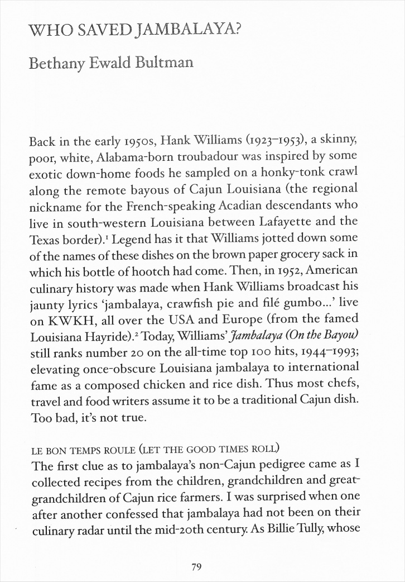
PPC #80 (March 2006)

Slide 9
Back on the trail of the elusive
“jambalaya.”

Slide 10
Charles Perry
Spoke with author and expert on Arab cookery, Charles Perry. He could provide no plausible antecedent for “jambaiala,” in any Arab language.
Where did Mistral get the idea that it was an Arab word. Perhaps he mean “foreign,” (e.g. “turkey.”) Perhaps since he related it to pilau, which is Arabic in origin, he felt it was Arabic?

Slide 11
Mistral’s Sources
The two Provençal quotes:
Fortuné (Fourtunat) Chailan - Leis amours de Vanus; vo, Lou paysan oou théâtré, 1837, and Lou Gangui – Contes, Anecdotos et Facétios en Vers Prouvençaoux, 1840.
Louis Charles Felix Peise, La Testo et la Coua de la Serp, from his book Leis Talounados de Barjomau, 1865.

Slide 12
Leis Amours de Vanus
A l’estanci plus haou fasien chavararin,
Aqui l’avié de toute de riche et mesquin:
Ero un jambaraya de fachos de cenobre*;
Coumo la chicarié qu’aven oou mes d’ooutobre,
Touto sorto d’oousseou li fasié son jargoun
(*) Figures rouges, avinées
The upstairs neighbors were making a din
All kinds of people, rich and poor:
It was a mish-mash [jambaraya] of red inebriated faces*;
As in the song birds that we have in October,
All kinds of birds were singing
(*) Red faces, inebriated

Slide 13
La Testo et la Coua de la Serp
Mai tout aco s’acouardo gaire,
Entantou cadun saup coumo la barquo va.
Aqueou jambalaia me remette en memori
Ce qu’arribet à uno vieilho ser,
Quand sa coua vouguet ave l’er
De passar per davant. Veici touto l’histori:
La coua disie per sa resoun:
— L’a ben troou long-temps qu’aco duro!
But all that does not agree,
However each of us knows how the boat is going.
This rabble [jambalaia] reminds me
Of the arrival of an old snake,
When its tail wanted the air
To pass in front. Here’s the story;
The tail gave as argument
-- It had been there for too long!

Slide 14
1837 - Figurative Use
Leis amours de Vanus published in 1837 is the earliest published use of the word “jambalaia” in any of its many forms, but the use is figurative, not culinary.
Culinary use doesn’t appear in Provence until Mistral’s dictionary in 1878.

Slide 15
End of the Provençal etymological road. Back to America and culinary usage.

Slide 16
Yaya?
There are hundreds of African languages. In virtually every language for which I could find a written dictionary, “rice” is some form of “riz” or “arroz.” No evidence that “yaya,” “aya,” or “ya,” means “rice” in any African language.

Slide 17
African Grasses
Burkhill, H. M., et. als. 1994. The Useful Plants of West Tropical Africa.
No rice varietals in Africa that have names like “yaya,” “aya,” or “ya.”
“Ya” in Mambila, and “yā” or “yala” in Grusi-Lyela refer to the grain sorghum, sorghum bicolor

Slide 18
No Rice. Ham?
Ham is almost always an ingredient in jambalaya recipes, however, is it the defining element?
If jambalaya is a version of Muslim Arab pilau, adding ham could be significant. Feels speculative.
Impossible to rule out, but equally impossible to substantiate.

Slide 19
Jumble of Jambalaya
Could “jambalaia” be related to “jumble?” British/French cross-pollination.
The Oxford English Dictionary says of “jumble” that it is “…Known only from the 16th c., and without cognate words. Prob. onomatopœic: cf. bumble, fumble, mumble, rumble, stumble, tumble.”
Pure speculation on my part.

Slide 20
Chronology
1837 - The first appearance of any variant of the word "jambalaya" in any language occurred in Leis amours de Vanus; vo, Lou paysan oou théatré, by Fortuné (Fourtunat) Chailan.
1840 - The same text by Chailan is reprinted in his next book Lou Gangui – Contes, Anecdotos et Facétios en Vers Prouvençaoux.
1849 - The earliest appearance of the word in print in English occurs in the May 1849 issue of the American Agriculturalist.
1865 - Louis Charles Felix Peise used the word "jambalaia" in his poem, "La Testo et la Coua de la Serp," from his book Leis Talounados de Barjomau.
1872 - The New-Orleans Times June 28, 1872 included a piece entitled "The Vous Dous Incantation," which makes reference to "...victuals, such as gumbo, jambalaya, etc."
1875 - The July 4, 1875 New-Orleans Times, supplement page 2 contains a piece on "Jam-ba-la-yah," which they call "...a favorite dish of the regular old Creole cuisine."
1875 - Jambalaya, spelled "jombalyeeyah," is referred to in The Cultivator and Country Gentleman, July 22, 1875
1876 - In an 1876 book entitled Louisiana As It Is, by Daniel Dennett, the word "jombalyeeah" is used.
1878 - The Gulf City Cook Book, by the Ladies of the St. Francis Street Methodist Episcopal Church, South Mobile, Alabama has a recipe for “JAM BOLAYA.” The first recipe in a cookbook discovered to date.
1878 - The Provencal word "jambalaia" is defined in Lou Tresor dou Felibrige ou Dictionnaire Provençal-Français by Frédéric Mistral. Mistral references the two works by Chailan and Peise noted above.
1881 - What Mrs. Fisher Knows About Old Southern Cooking, Soups, Pickles, Preserves, Etc. by Abby Fisher is published in San Francisco by the Women’s Co-operative Printing Office. Includes her recipe for "Jumberlie - A Creole Dish.”

Slide 21
Chronology (cont)
1885 - Creole Cookery by the Christian Woman’s Exchange New Orleans - Has a recipe for Jumballaya, a Spanish Creole dish.
1885 - La Cuisine Creole - Lafcadio Hearn's recipes (including Jambalaya) were mainly contributed by Mrs. Rudolph Matas, the wife of a prominent Tulane University surgeon, according to the Hearn’s website keeper/master.
1893 - The January 1893 edition of Harper's New Monthly Magazine ran an article entitled "The Old Way to Dixie." The article refers to "jambullade."
1893 - Favorite Dishes. A Columbian Autograph Souvenir, compiled by Carrie V. Shuman of Chicago - Under Poultry, "Jambolaya (A Spanish Creole Dish)" submitted by Miss Katharine L. Minor, Louisiana.
1900 - Laurel Cook Book, ed. Mrs. George Gardiner. Laurel, Mississippi. - Recipe #429, Jambalaya.
1901 - Mme Begue and her Recipes. Old Creole Cookery - The Friday menu which includes jambalaya of rice and shrimps. Recipes for "jambalaya or rice and shrimp" and "jambalaya of chicken" appear later in the book.
1901 - Picayune's Creole Cook Book - Devotes a whole chapter to Louisiana Rice Recipes; Creole Jambalaya, "a Spanish Creole dish which is a great favorite in New Orleans." Crab Jambalaya, Jambalaya au Congri and Shrimp Jambalaya. Also included are recipes for "a French pilou," and "Pilaff of chicken."
1902 - Southern Pacific Rice Cook Book, ed. Mrs. S. A. Knapp - Jambalaya in five different recipes.
1904 - Cooking in Old Creole Days by Celestine Eustis provides her recipe for "Jumballaya a la Creole.”
1905 - "Jambalaya," with the familiar spelling, appears on page 156 of a book titled New Orleans As It Was, by Henry C. Castelanos, 1905 [c1895].

Slide 22
Important Dates
The important dates are:
1837 – The first printed use in Provence, figurative.
1849 – The first printed use in the USA, culinary.
1878 – Mistral refers to the word with both figurative and culinary use in Provence.
1878 – The first recipe in a cookbook (USA.)

Slide 23
A Jambalaya of Dates
The figurative use in Provence predates the culinary use in America, but only by 12 years.
The culinary use in American predates the first European culinary reference (Mistral’s dictionary) by 29 years. “Jambalaya” never appears in a European cookbook.

Slide 24
Many Questions
Where did the recipe originate?
Where was the word coined?
Were they created together, or was the existing word “jambalaya” applied to the dish. If so, did the recipe exist before it was named “jambalaya,” or was it named at birth.

Slide 25
“Jambalaya” the Vagabond
We know that “jambalaya” existed as both a word and a recipe at various times in America and in Provence.
How did the word get from its source to its destination?
How did the recipe move around?
Did they travel together?

Slide 26
Native American?
Lafcaido Hearn in the Creole Cook Book (1885): “…it is said to be an Indian dish…” Probably a mistake. Some Creole families used sagamite instead of rice in Jambalaya, and there was said to be a similar Native American dish that used wild rice and beans. Perhaps this gave Hearn the idea it was “Indian.”

Slide 27
African?
The “a la yaya” story is unlikely, but West Africa has had cultivated rice for centuries, and certainly had single-pot rice dishes such as “Jollof rice.”
Wollof (aka Jollof) is a West African language. The dish “benachin” (meaning “one pot” in Wollof) is very similar to jambalaya.
West African slaves worked in the kitchens of Louisiana slave owners.
It has been suggested that “jambalaya” is a corruption of “jollof.” Seems tenuous.
The dish could have come from Africa, but it is unlikely the word did.

Slide 28
Provençal?
Provence has the earliest use of the word in a figurative sense, but no printed recipes.
Pilau came to Provence from the Arab world. Perhaps “jambalaia” (meaning mish-mash) was applied to that recipe.
The word disappeared because the French government suppressed regional languages.
The recipe would not have been recorded because literate Parisians ignored provincial cooking.
Provençal’s could have retained the recipe but gone back to calling it “Pilau.” In the meantime, the name went to the USA and was orphaned there.
Interestingly, there is a dish called “jambinetto” defined in a 1785 Provençal dictionary. Some relationship? No evidence in cookbooks.

Slide 29
Spanish?
There are frequent references in early cookbooks to jambalaya being “a Spanish Creole dish.”
Louisiana was nominally Spanish from 1764 to 1800. Spain sent adminstrators who brought household staff with them. Could have brought jambalaya at that time.
Spain has a history of rice dishes in the form of paella. Jambalaya could be Spanish without being a direct descendent of paella.
If it was Spanish, then it is most likely Catalan; There is a connetion between Catalan and Occitan, and a dialect of Occitan was spoken in the Aran Valley region of Catalonia.

Slide 30
Louisiana Cajun/Creole?
Hard to substantiate.
It is not clear how the word in a culinary sense would have travelled back to Provence. Emmigration was from the old world to the new.
Carolina rice was popular in Paris. If the rice trade was a vector for transmission of the recipe, one would expect to find recipes in Paris.
The Cajun’s had little or no rice in Acadia (Eastern Canada) before emmigration to Louisiana in 1755. No prior tradition of rice cookery.
Early recipes for similar dishes (pilau, hopping john, etc.) exist elsewhere.

Slide 31
Stirring a Common Pot
Everyone who has rice, has a one pot dish like jambalaya. Pilau, pilaff, paella, arroz con pollo, Jollof rice (benachin,) hopping John…
Everyone comes up with their own folk stories to claim the dish as their own.

Slide 32
Conclusions
I believe the word “jambalaya” is Provençal.
I suspect the dish was originally Provençal as well, and came to the US with French or Spanish settlers.
I believe the dish that we know today is richer and spicier than the original, which was probably a mild pilau.
I am sure that many cultures can take credit in evolving the recipe.
I am prepared to be proven wrong on any of these counts, and anxiously look forward to hearing of new evidence for the origins of jambalaya.

Slide 33
Stop the Presses! Mobile, Alabama?
The first use in print in the USA was submitted to the American Agriculturist by Solon Robinson, writing from Alabama.
A newly discovered first recipe in a cookbook: The Gulf City Cook Book was printed in South Mobile, Alabama.
Abbie Fisher, born a slave in North Carolina, lived in Mobile, Alabama before moving to San Francisco where her cookbook was published.
Might Bethany Bultman have been on to something? Could the idea of jambalaya’s Cajun connection be a red herring resulting from the popularity of the Hank Williams song?
Alabama has a similar history to Louisiana: Spanish, then French, then Spanish, then part of the United States: the arguments about cultural transmission applied to Louisiana can be made about Alabama.

Slide 34
Andrew Sigal
www.sigal.org
http://www.sigal.org/CulinaryHistory/Jambalaya/Jambalaya.htm

